Slide 2
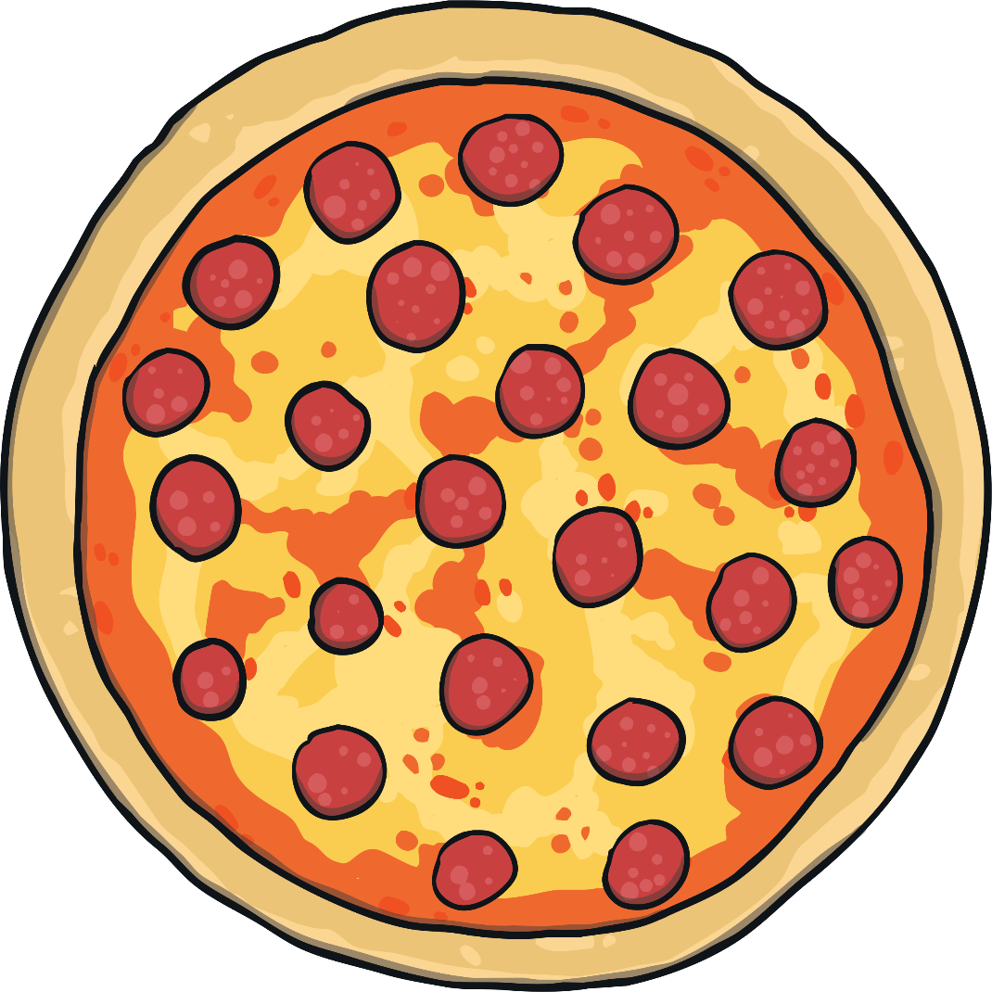
1 whole

Slide 3
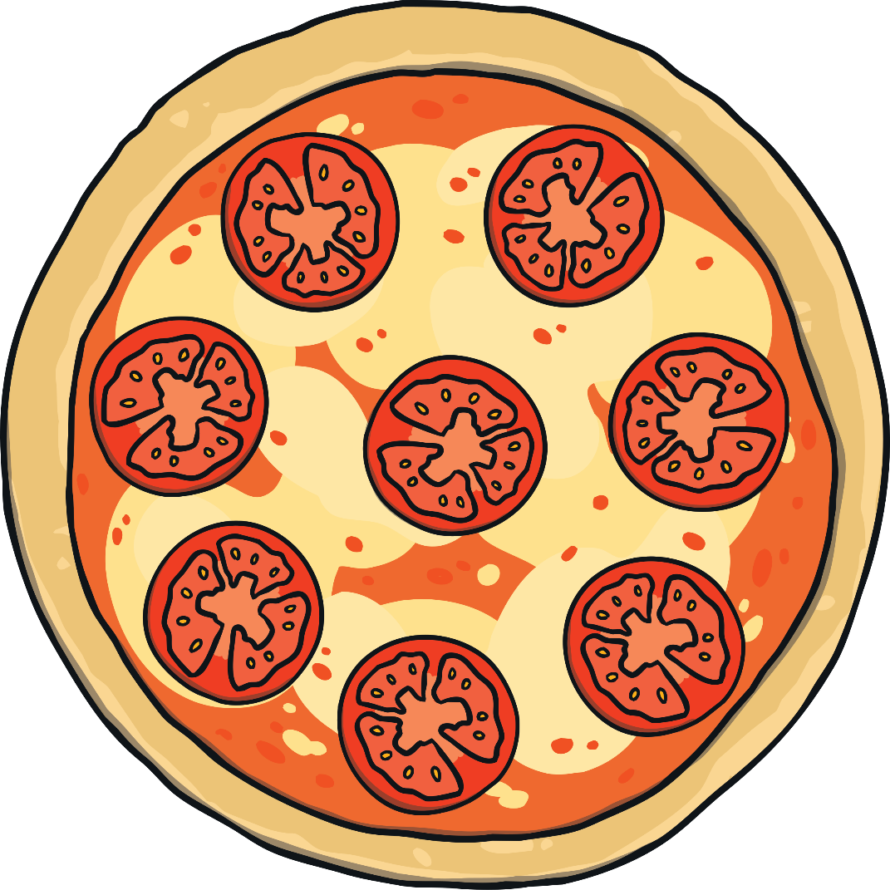
2 halves

Slide 4
4 quarters

Slide 5
1 half (½)

Slide 6
3 quarters (¾)

Slide 7
2 quarters ( )

Slide 8
1 quarter (¼)

Slide 9
2 quarters= 1 half (½)

